Slide 1
A Presentation on how to clone disk C onto another LOCAL disk/DRIVE
By Ainebyona Aaron

Slide 2
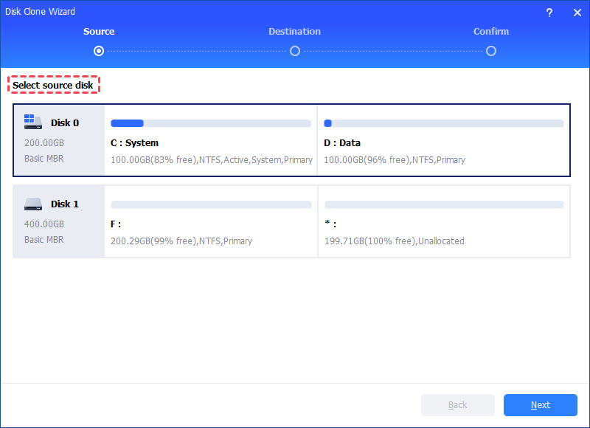
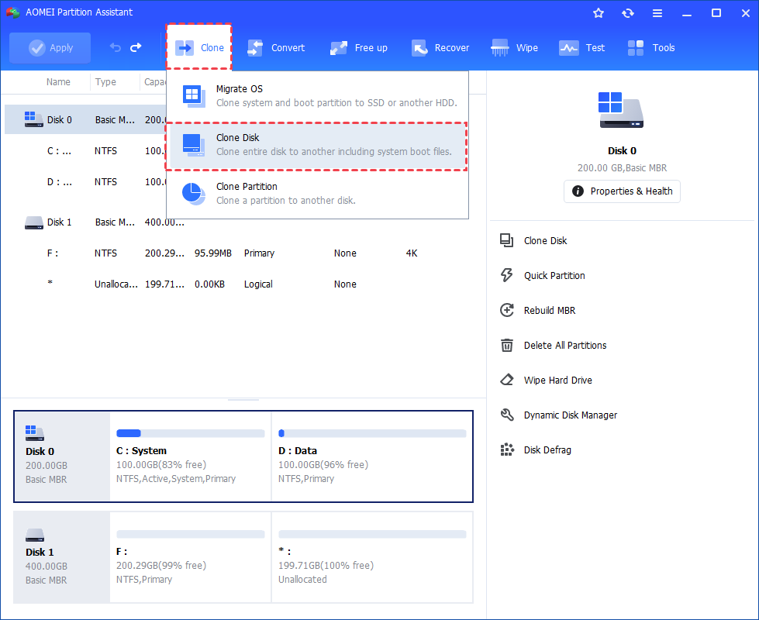
Install and launch AOMEI partition assistant, click the “Clone" main tab and select “Clone Disk“ or you can also right-click the disk you want to clone and select the “Clone Disk" tool to run disk clone.
Choose the hard disk that you need to clone as the source disk and click “Next".

Slide 3
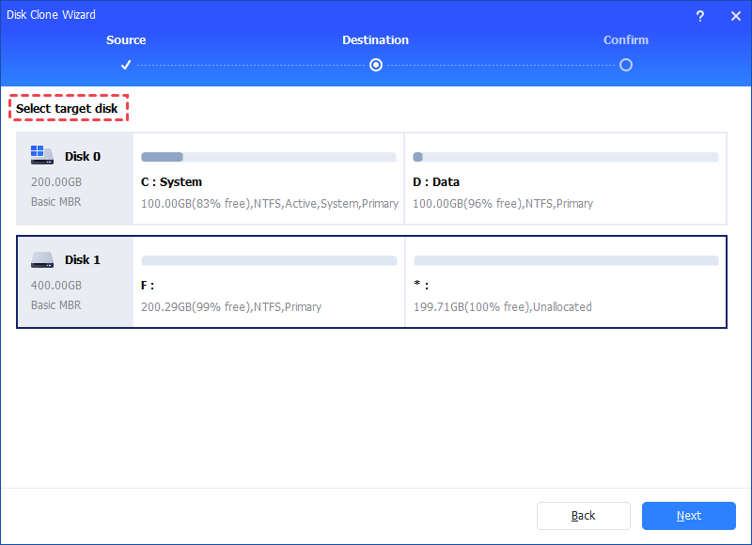
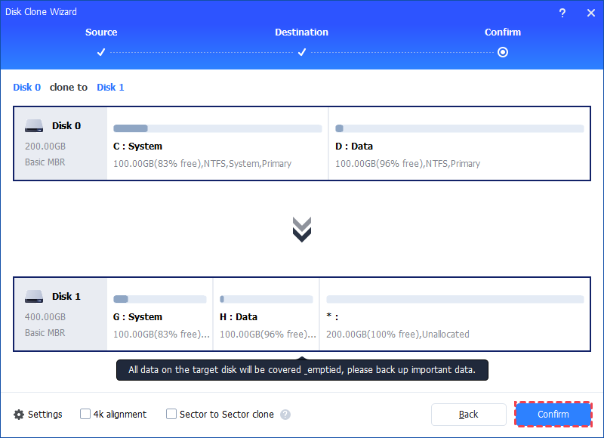
Select the destination disk to put the data of the source disk on, and then click “Next".
Then, you will enter the Confirm interface where you can check the source and destination disk. After all is set, you can click the “Confirm" button to continue.

Slide 4
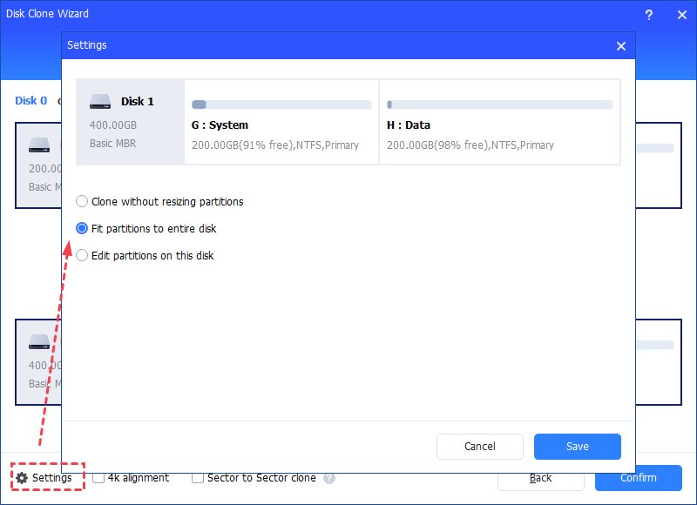
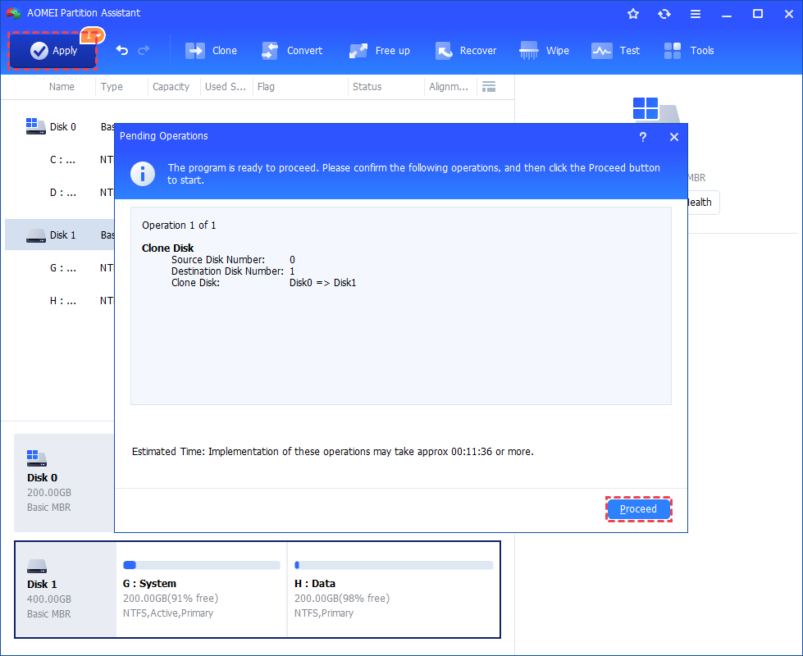
In the next window, you can click the “Settings" button to adjust the partition size on the destination disk.
You can preview the disk cloning operating by viewing the “Pending Operations". To commit the “Pending Operations", please click “Apply" and “Proceed".

Slide 5
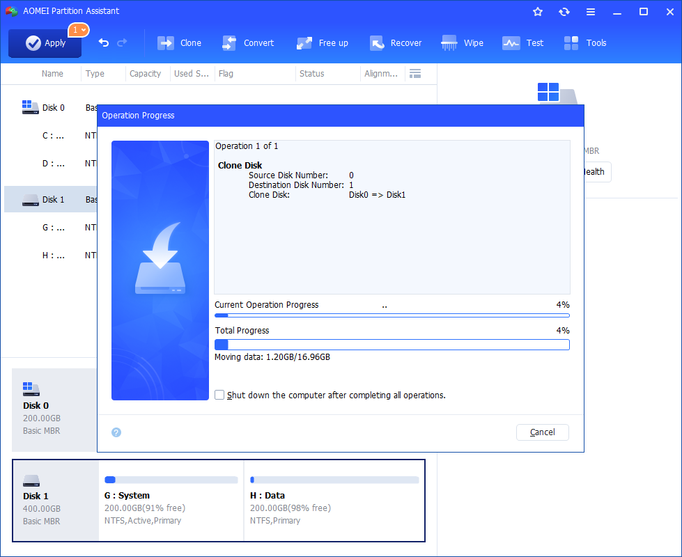
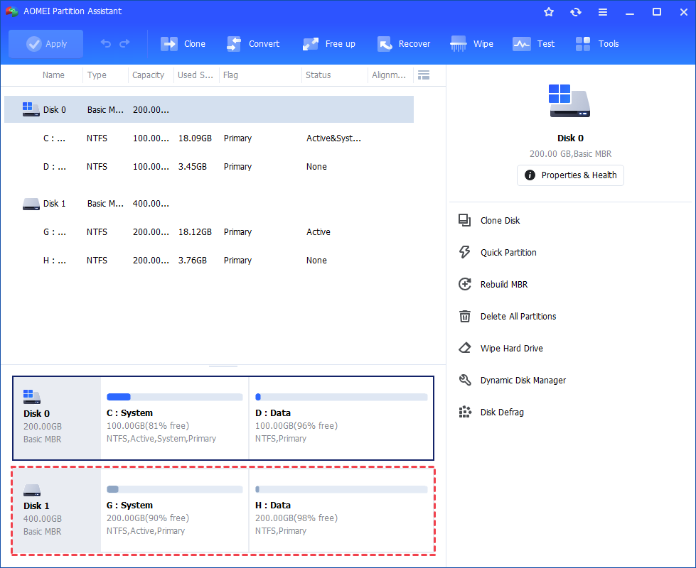
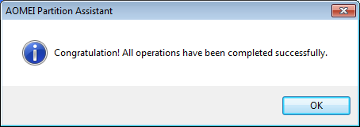
The cloning process will start and you can check the cloning process.
Once the process is completed successfully, you will get a congratulation window.
As a result, you can check the partitions layout on the destination disk will be identical to the source disk.

